Slide 1

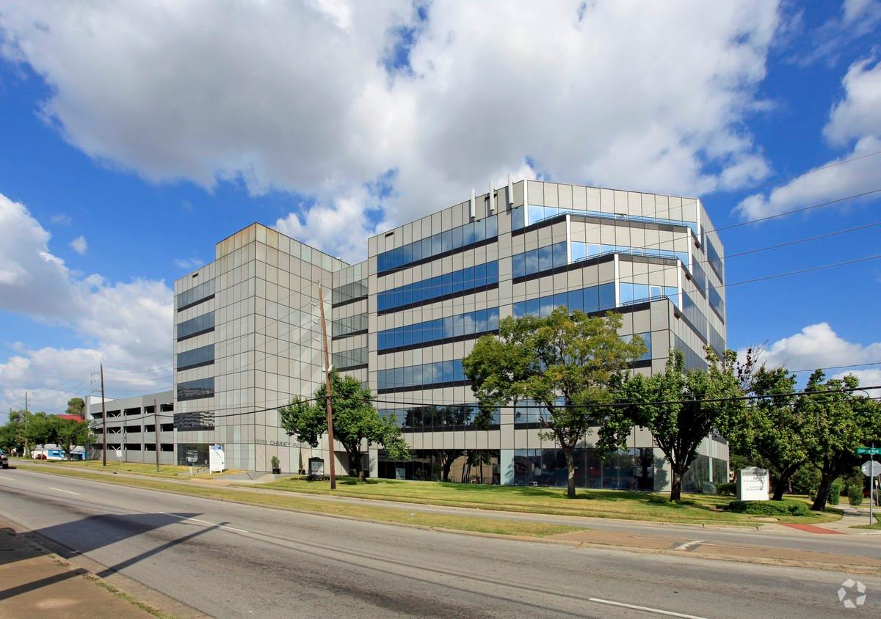

After3 After-School Program
Selecting an Electronic System to
Best Suit Our Needs
UH D. Student
University of Houston - Downtown
August 10, 2017

Slide 2


An electronic system will streamline work time and raise productivity.

Slide 3
Our current system costs us $4000 a month and does not benefit us.

Slide 4
The best system for After 3 is ProCare Software (based on 700 students) per month.

Slide 5
ProCare has a more expensive start up but still also is the most affordable and beneficial.

Slide 6
ProCare will streamline our company while saving money.

